Slide 1
COMP 2230
Week 6 - Wednesday

Slide 2
Last time
Second order linear homogeneous recurrence relations with constant coefficients
General recursion
Started set theory review

Slide 3
Questions?

Slide 4
Assignment 3

Slide 5

Logical warmup
You have to do an experiment to determine the highest floor on a 100-story building from which a bowling ball can be dropped without breaking.
You are given two identical bowling balls to carry out your experiment.
If a ball doesn't break after being dropped, it may be reused without suffering any damage. But if both balls break before you find the highest floor, you're fired.
What is the least number of times you must drop the bowling balls in order to find the highest floor?

Slide 6
Back to Set Theory

Slide 7
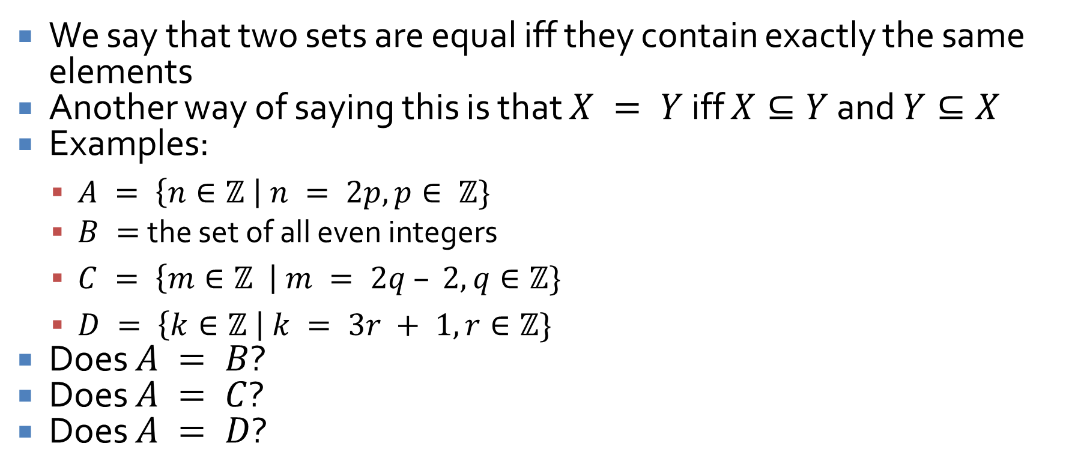
Set equality
We say that two sets are equal iff they contain exactly the same elements
Another way of saying this is that $X = Y$ iff $X⊆Y$ and $Y⊆X$
Examples:
  $A = \left\{n∈ℤ \right| n = 2p, p∈ ℤ\}$
  $B =$ the set of all even integers
  $C = \left\{m∈ℤ \right| m = 2q – 2, q∈ℤ\}$
  $D = \left\{k∈ℤ \right| k = 3r + 1, r∈ℤ\}$
Does $A = B$?
Does $A = C$?
Does $A = D$?

Slide 8
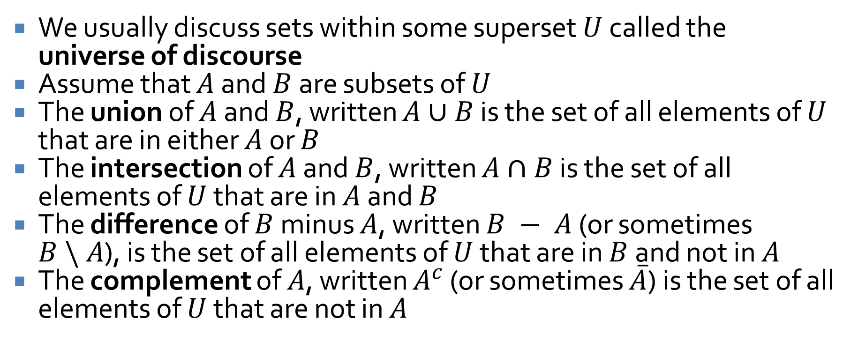
Set operations
We usually discuss sets within some superset $U$ called the universe of discourse
Assume that $A$ and $B$ are subsets of $U$
The union of $A$ and $B$, written $A∪B$ is the set of all elements of $U$ that are in either $A$ or $B$
The intersection of $A$ and $B$, written $A∩B$ is the set of all elements of $U$ that are in $A$ and $B$
The difference of $B$ minus $A$, written $B − A$ (or sometimes $B \backslash A$), is the set of all elements of $U$ that are in $B$ and not in $A$
The complement of $A$, written $A^{c}$ (or sometimes $\overline{A}$) is the set of all elements of $U$ that are not in $A$

Slide 9

Examples
Let $U = \{a, b, c, d, e, f, g\}$
Let $A = \{a, c, e, g\}$
Let $B = \{d, e, f, g\}$
What are:
  $A∪B$
  $A∩B$
  $B − A$
  $A^{c}$

Slide 10
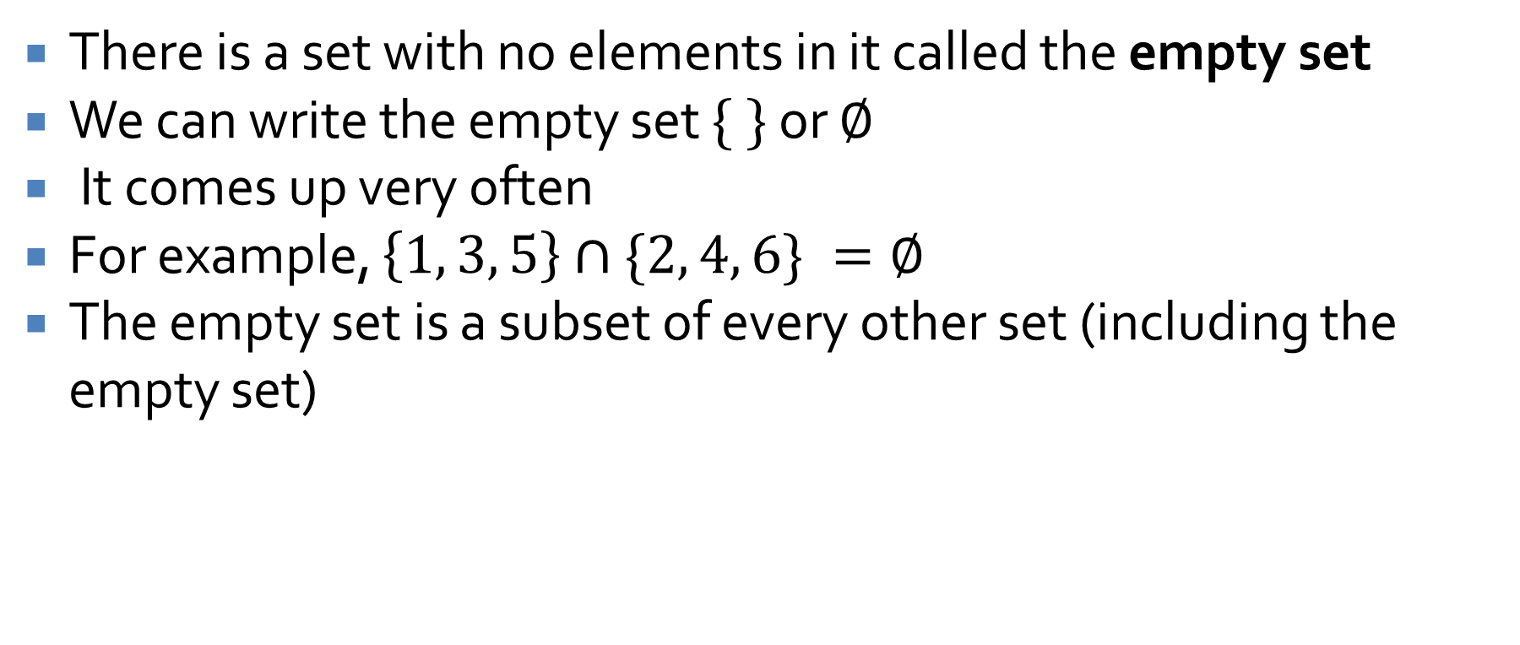
The empty set
There is a set with no elements in it called the empty set
We can write the empty set $\{ \}$ or $∅$
It comes up very often
For example, $\left\{1, 3, 5\right\}∩\{2, 4, 6\} =∅$
The empty set is a subset of every other set (including the empty set)

Slide 11
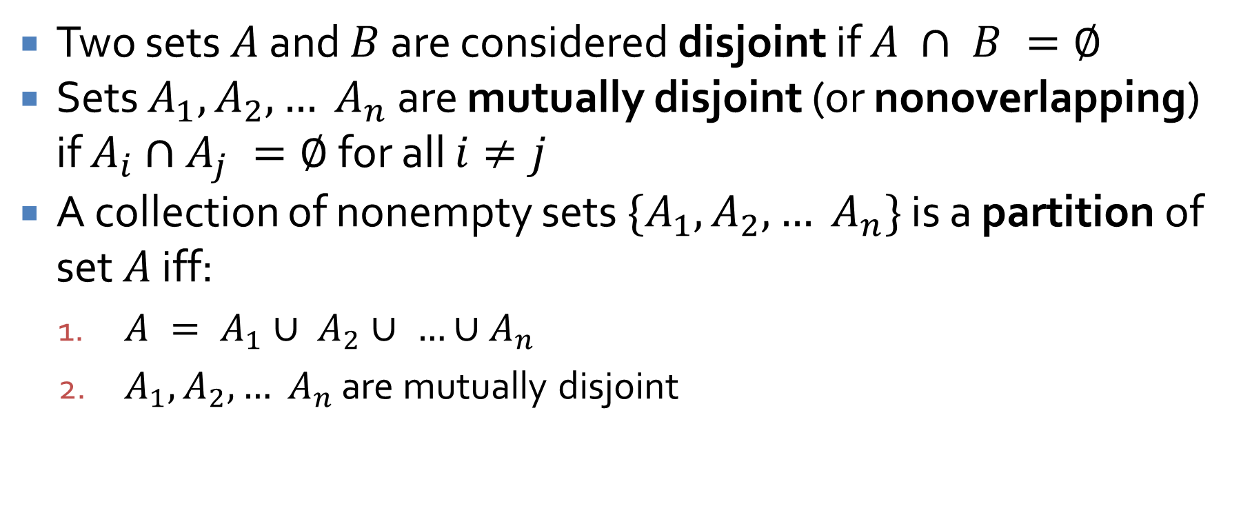
Disjoint sets and partitions
Two sets $A$ and $B$ are considered disjoint if $A ∩ B =∅$
Sets $A_{1}, A_{2}, … A_{n}$ are mutually disjoint (or nonoverlapping) if $A_{i}∩A_{j} =∅$ for all $i≠j$
A collection of nonempty sets $\{A_{1}, A_{2}, … A_{n}\}$ is a partition of set $A$ iff:
  $A = A_{1}∪ A_{2}∪ …∪A_{n}$
  $A_{1}, A_{2}, … A_{n}$ are mutually disjoint

Slide 12
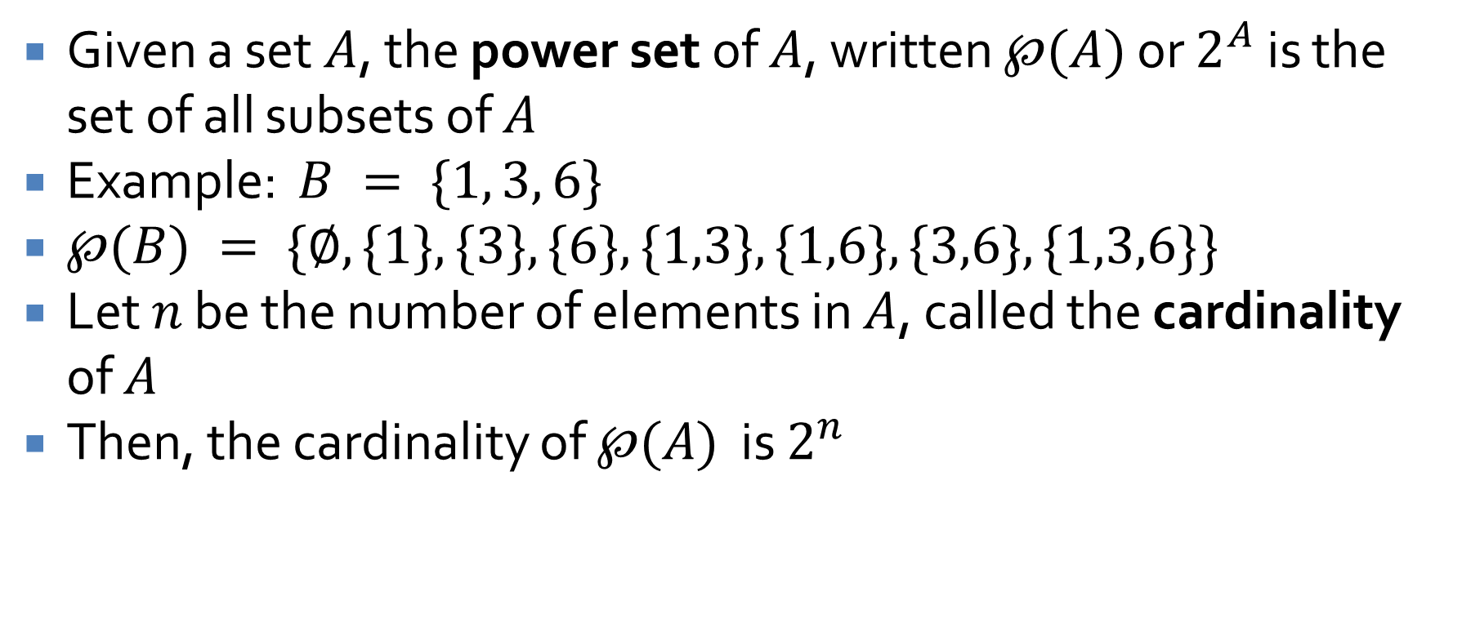
Power set
Given a set $A$, the power set of $A$, written $℘(A)$ or $2^{A}$ is the set of all subsets of $A$
Example: $B = \{1, 3, 6\}$
$℘(B) = \{∅, \{1\}, \{3\}, \{6\}, \{1,3\}, \{1,6\}, \{3,6\}, \{1,3,6\}\}$
Let $n$ be the number of elements in $A$, called the cardinality of $A$
Then, the cardinality of $℘(A)$ is $2^{n}$

Slide 13
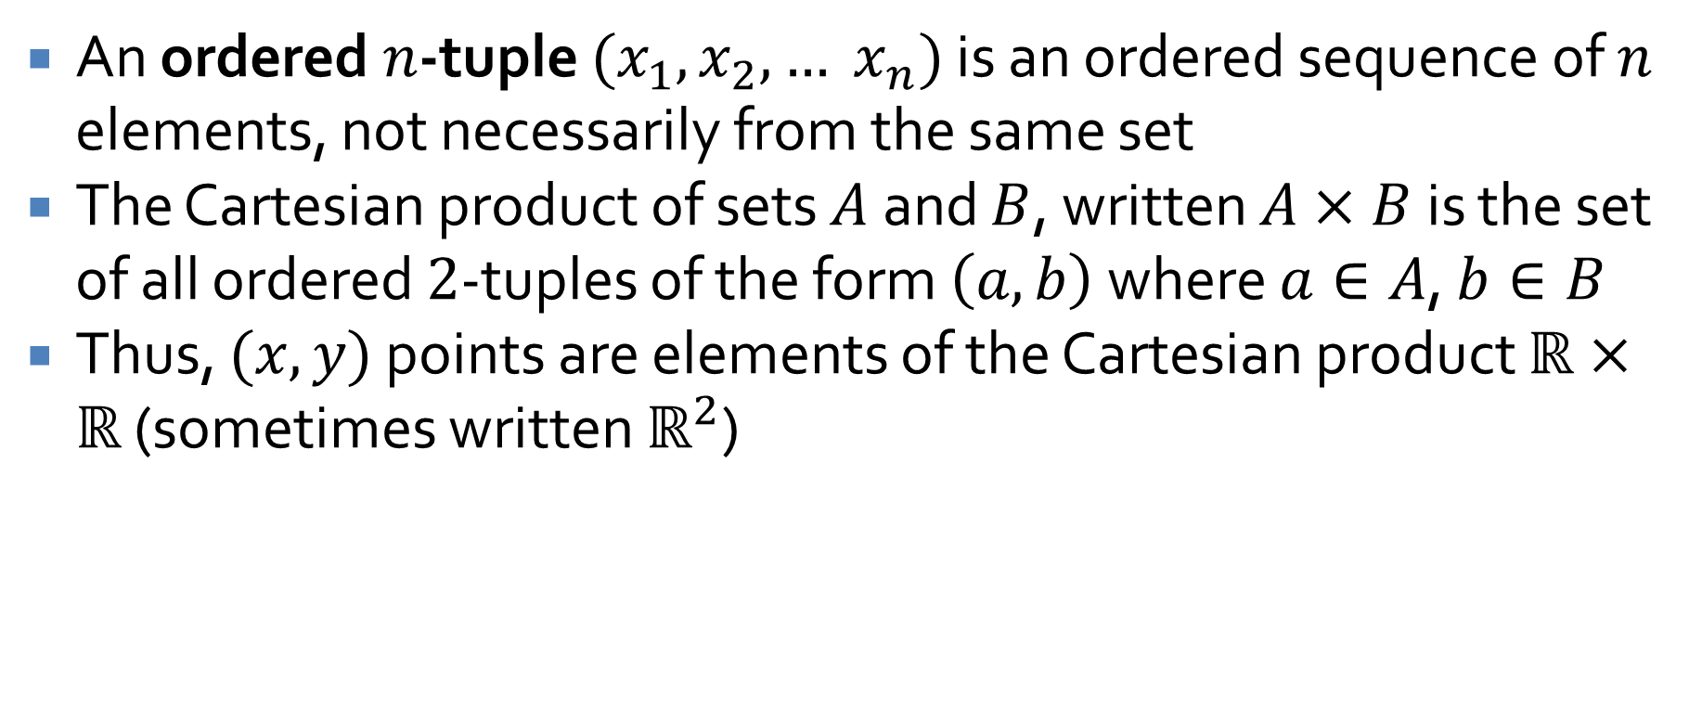
Cartesian product
An ordered $n$-tuple $(x_{1}, x_{2}, … x_{n})$ is an ordered sequence of $n$ elements, not necessarily from the same set
The Cartesian product of sets $A$ and $B$, written $A×B$ is the set of all ordered $2$-tuples of the form $\left(a, b\right)$ where $a∈A$, $b∈B$
Thus, $(x, y)$ points are elements of the Cartesian product $ℝ×ℝ$ (sometimes written $ℝ^{2}$)

Slide 14
Subset Relations

Slide 15
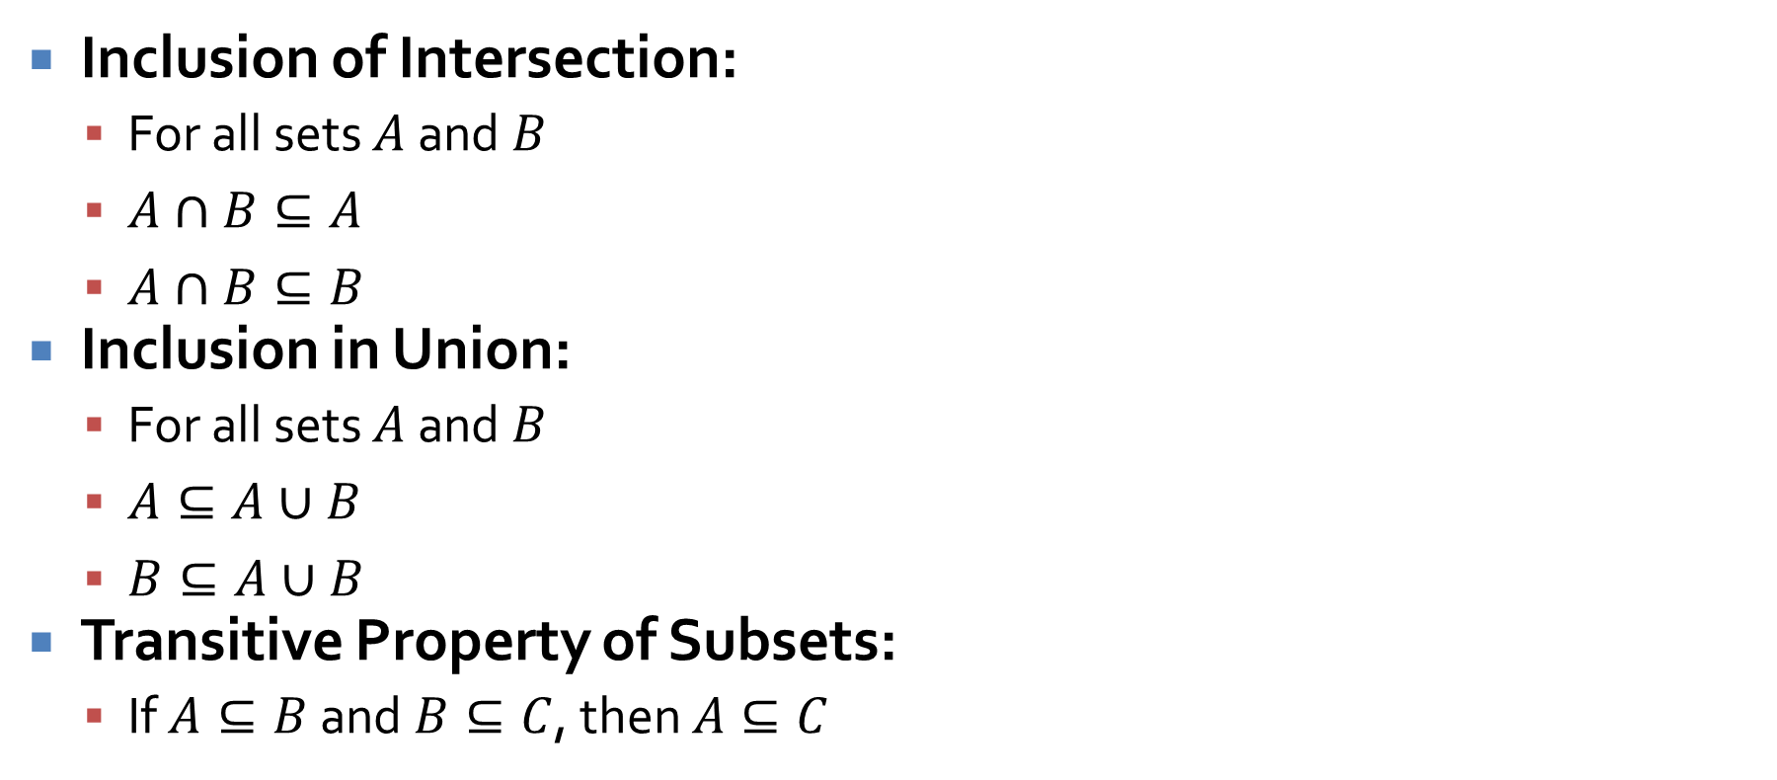
Basic subset relations
Inclusion of Intersection:
  For all sets $A$ and $B$
  $A∩B⊆A$
  $A∩B⊆B$
Inclusion in Union:
  For all sets $A$ and $B$
  $A⊆A∪B$
  $B⊆A∪B$
Transitive Property of Subsets:
  If $A⊆B$and $B⊆C$, then $A⊆C$

Slide 16
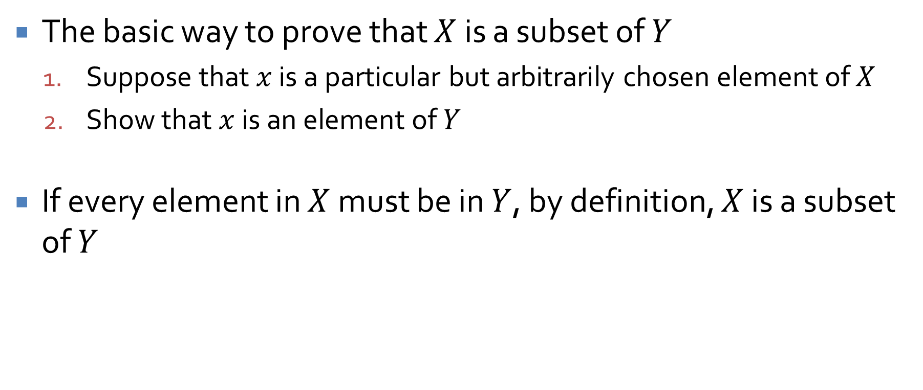
Element argument
The basic way to prove that $X$ is a subset of $Y$
  Suppose that $x$ is a particular but arbitrarily chosen element of $X$
  Show that $x$ is an element of $Y$
If every element in $X$ must be in $Y$, by definition, $X$ is a subset of $Y$

Slide 17
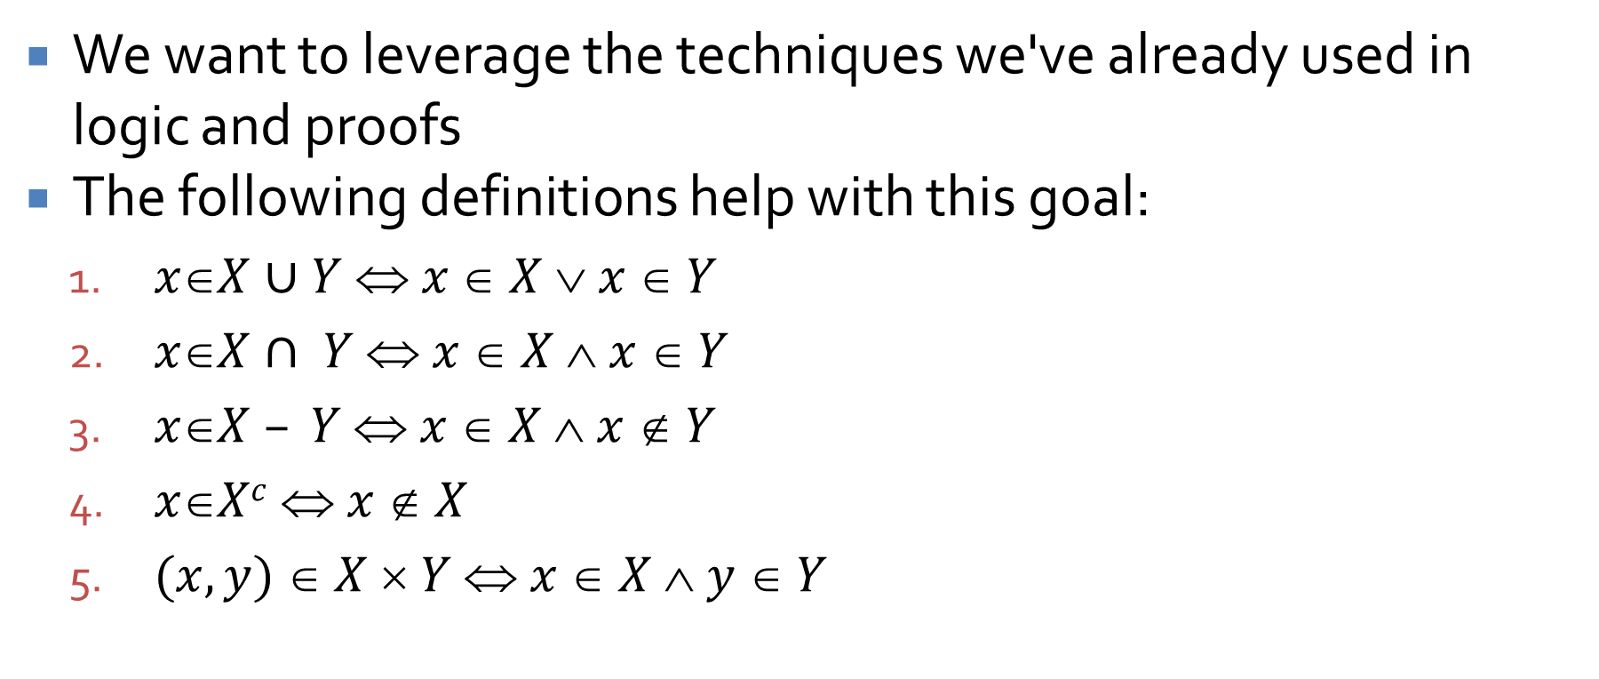
Procedural versions
We want to leverage the techniques we've already used in logic and proofs
The following definitions help with this goal:
  $xX∪Y  x  X  x  Y$
  $xX∩ Y  x  X  x  Y$
  $xX – Y  x  X  x  Y$
  $xXc  x  X$
  $(x, y)  X  Y  x  X  y  Y$

Slide 18
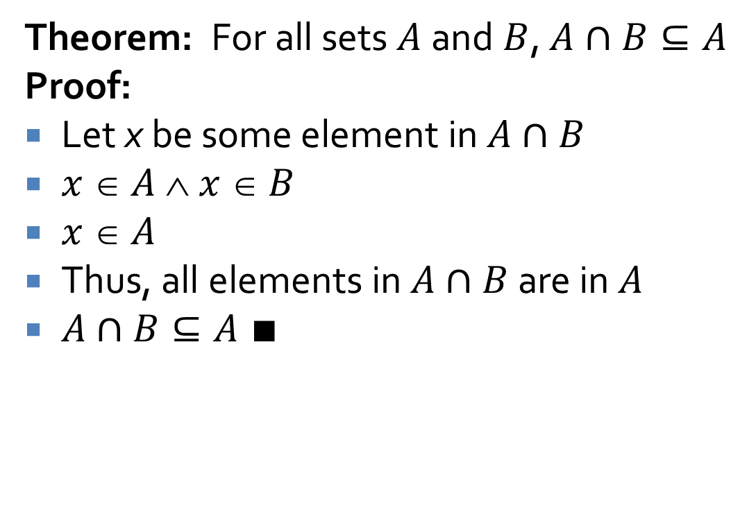
Example proof
Theorem: For all sets $A$ and $B$, $A∩B⊆A$
Proof:
Let x be some element in $A∩B$
$x  A  x  B$
$x  A$
Thus, all elements in $A∩B$ are in $A$
$A∩B⊆A ∎$
Premise
Definition of intersection
Specialization
By generalization
Definition of subset

Slide 19
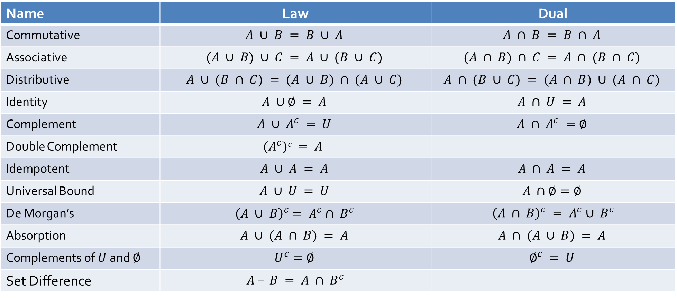
Laying down the law (again)
Name | Law | Dual
Commutative | $$A ∪ B = B ∪ A$$ | $$A ∩ B = B ∩ A$$
Associative | $$(A ∪ B) ∪ C = A ∪ (B ∪ C)$$ | $$(A ∩ B) ∩ C = A ∩ (B ∩ C)$$
Distributive | $$A ∪ (B ∩ C) = (A ∪ B) ∩ (A ∪ C)$$ | $$A ∩ (B ∪ C) = (A ∩ B) ∪ (A ∩ C)$$
Identity | $$A ∪∅ = A$$ | $$A ∩ U = A$$
Complement | $$A ∪ A^{c} = U$$ | $$A ∩ A^{c} =∅$$
Double Complement | $$(A^{c})c = A$$
Idempotent | $$A ∪ A = A$$ | $$A ∩ A = A$$
Universal Bound | $$A ∪ U = U$$ | $$A ∩∅=∅$$
De Morgan’s | $${\left(A ∪ B\right)}^{c}= A^{c}∩ B^{c}$$ | ${\left(A ∩ B\right)}^{c} = A^{c}∪ B^{c}$
Absorption | $$A ∪ (A ∩ B) = A$$ | $$A ∩ (A ∪ B) = A$$
Complements of $U$ and $∅$ | $$U^{c}=∅$$ | $$∅^{c} = U$$
Set Difference | $A – B = A ∩ B^{c}$

Slide 20

Proving set equivalence
To prove that $X = Y$
  Prove that $X⊆Y$ and
  Prove that $Y⊆X$

Slide 21
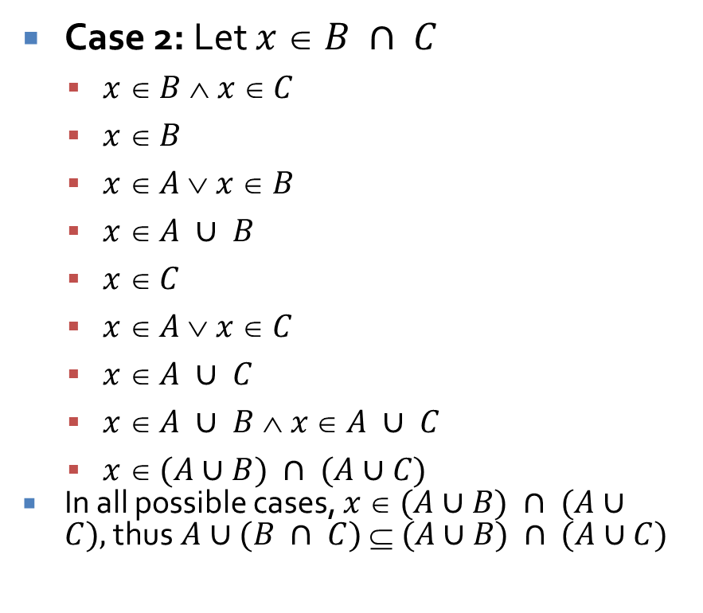
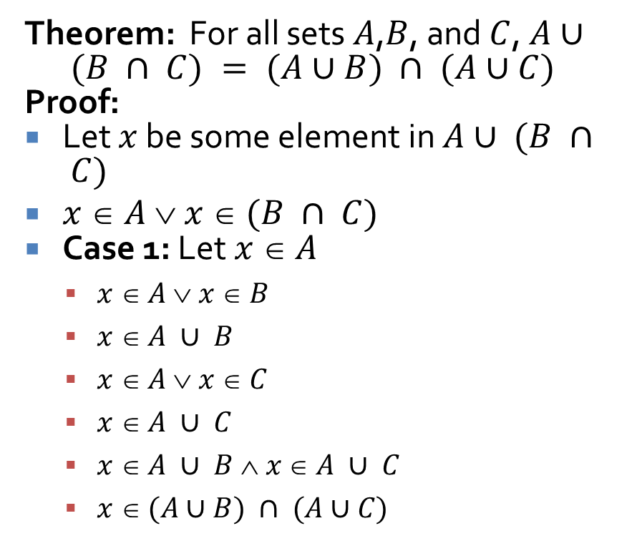
Example proof of equivalence
Theorem: For all sets $A$,$B$, and $C$, $A∪ (B ∩ C) = (A∪B) ∩ (A∪C)$
Proof:
Let $x$ be some element in $A∪ (B ∩ C)$
$x  A  x  (B ∩ C)$
Case 1: Let $x  A$
  $x  A  x  B$
  $x  A ∪ B$
  $x  A  x  C$
  $x  A ∪ C$
  $x  A ∪ B  x  A ∪ C$
  $x  (A∪B) ∩ (A∪C)$
Case 2: Let $x  B ∩ C$
  $x  B  x  C$
  $x  B$
  $x  A  x  B$
  $x  A ∪ B$
  $x  C$
  $x  A  x  C$
  $x  A ∪ C$
  $x  A ∪ B  x  A ∪ C$
  $x  (A∪B) ∩ (A∪C)$
  In all possible cases, $x  (A∪B) ∩ (A∪C),$thus$A∪(B ∩ C)  (A∪B) ∩ (A∪C)$

Slide 22
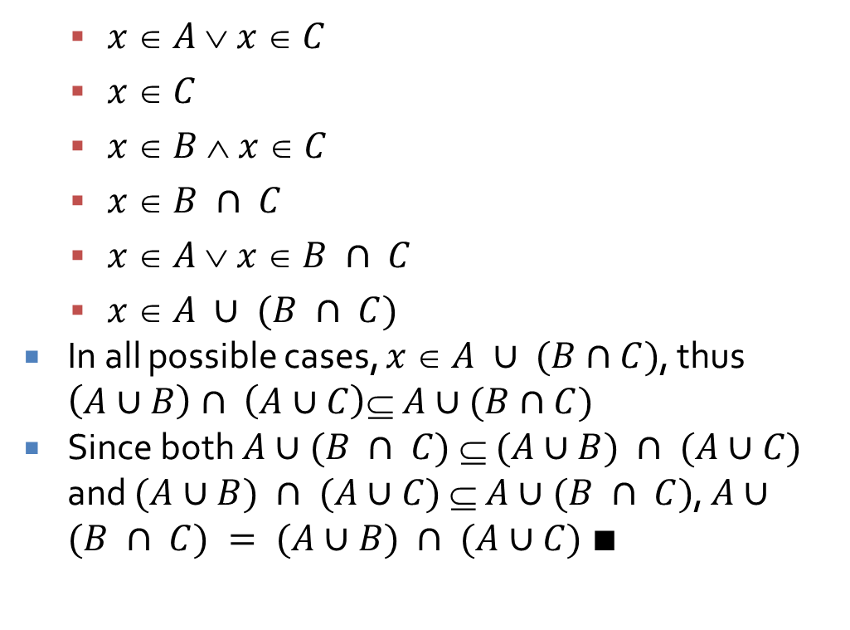
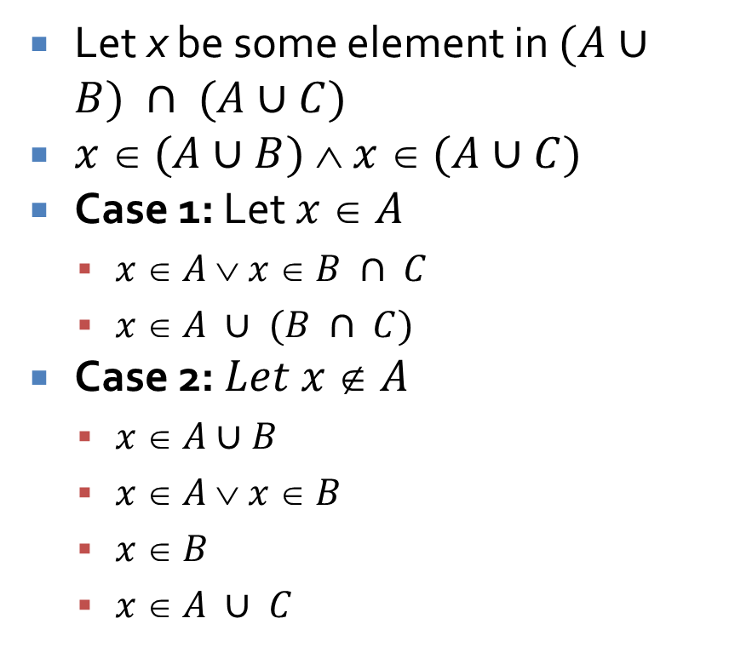
Proof of equivalence continued
Let x be some element in $(A∪B) ∩ (A∪C)$
$x  (A∪B)  x  (A∪C)$
Case 1: Let $x  A$
  $x  A  x  B ∩ C$
  $x  A ∪ (B ∩ C)$
Case 2: $Let x  A$
  $x  A∪B$
  $x  A  x  B$
  $x  B$
  $x  A ∪ C$
  $x  A  x  C$
  $x  C$
  $x  B  x  C$
  $x  B ∩ C$
  $x  A  x  B ∩ C$
  $x  A ∪ (B ∩ C)$
  In all possible cases, $x  A ∪ (B∩C)$, thus $\left(A∪B\right)∩ \left(A∪C\right)⊆ A∪(B∩C)$
  Since both $A∪(B ∩ C)  (A∪B) ∩ (A∪C)$ and $(A∪B) ∩ (A∪C)  A∪(B ∩ C)$, $A∪(B ∩ C) = (A∪B) ∩ (A∪C)$ $∎$

Slide 23
Disproofs and Algebraic Proofs

Slide 24
Disproving a set property
Like any disproof for a universal statement, you must find a counterexample to disprove a set property
For set properties, the counterexample must be a specific examples of sets for each set in the claim

Slide 25

Counterexample example
Claim: For all sets $A$, $B$, and $C$, $\left(A – B\right)∪(B – C) = A – C$
Find a counterexample

Slide 26
Algebraic set identities
We can use the laws of set identities given before to prove a statement of set theory
Be extremely careful (even more careful than with propositional logic) to use the law exactly as stated

Slide 27
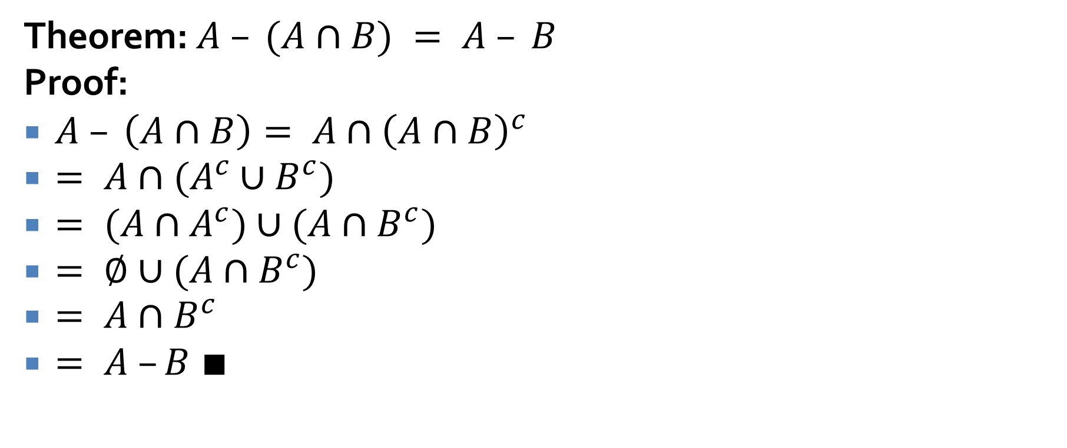
Algebraic set identity example
Theorem: $A – (A∩B) = A – B$
Proof:
$A – \left(A∩B\right)= A∩{\left(A∩B\right)}^{c}$
$= A∩(A^{c}∪B^{c})$
$= (A∩A^{c})∪(A∩B^{c})$
$= ∅∪(A∩B^{c})$
$= A∩B^{c}$
$= A –B ∎$

Slide 28

Prove or disprove
For all sets $A$, $B$, and $C$, if $A⊈B$ and $B⊈C$, then $A⊈C$

Slide 29

Prove or disprove
For all sets $A$ and $B$, ${\left(\left(A^{c}∪B^{c}\right)– A\right)}^{c} = A$

Slide 30
Russell's Paradox

Slide 31
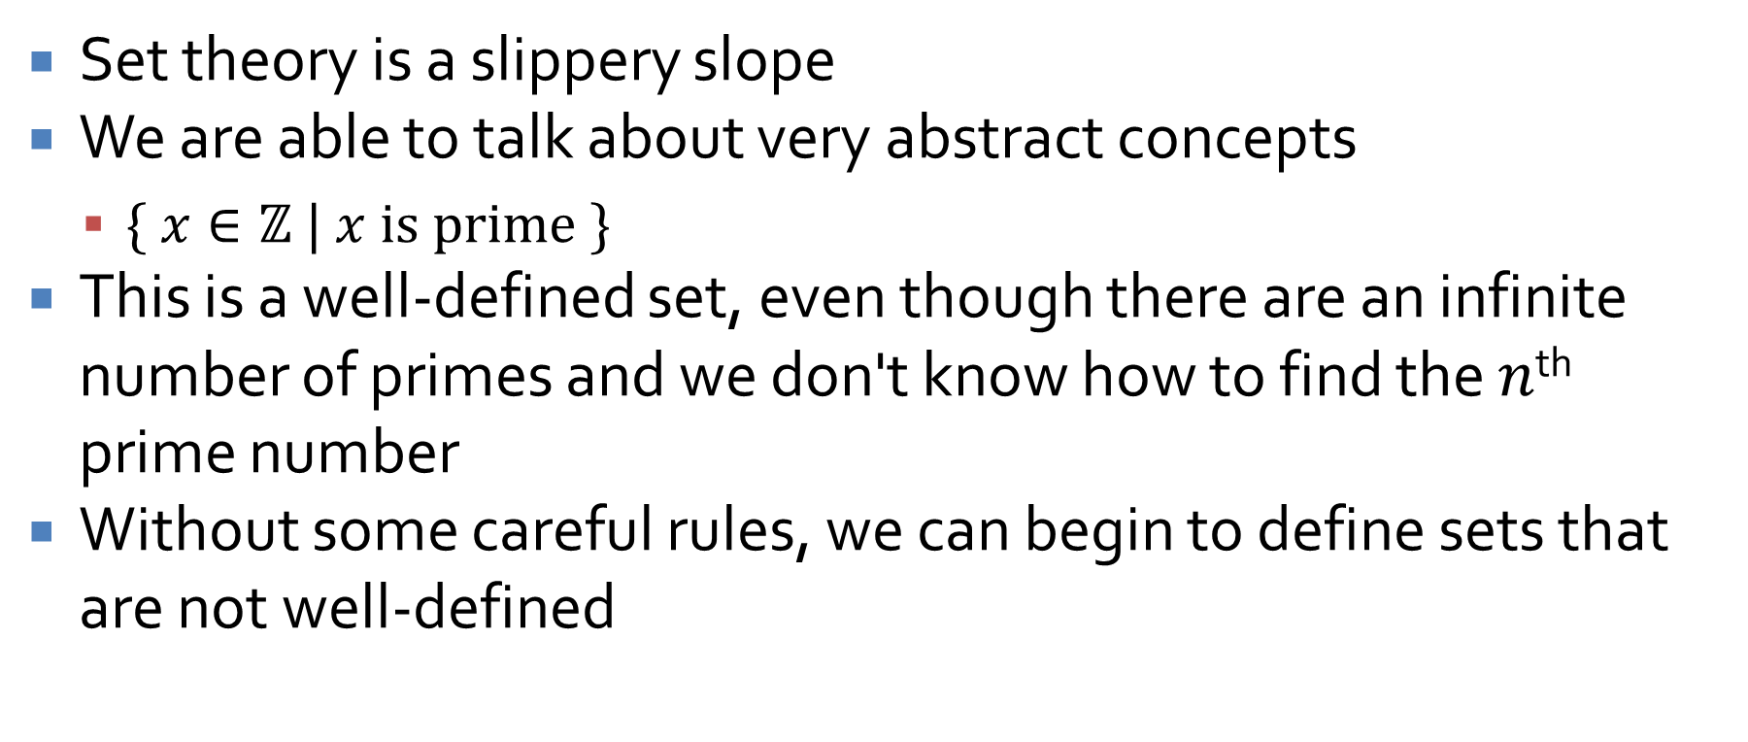
Naïve set theory
Set theory is a slippery slope
We are able to talk about very abstract concepts
  $\{ x∈ℤ | x is prime \}$
This is a well-defined set, even though there are an infinite number of primes and we don't know how to find the $n$^{th} prime number
Without some careful rules, we can begin to define sets that are not well-defined

Slide 32

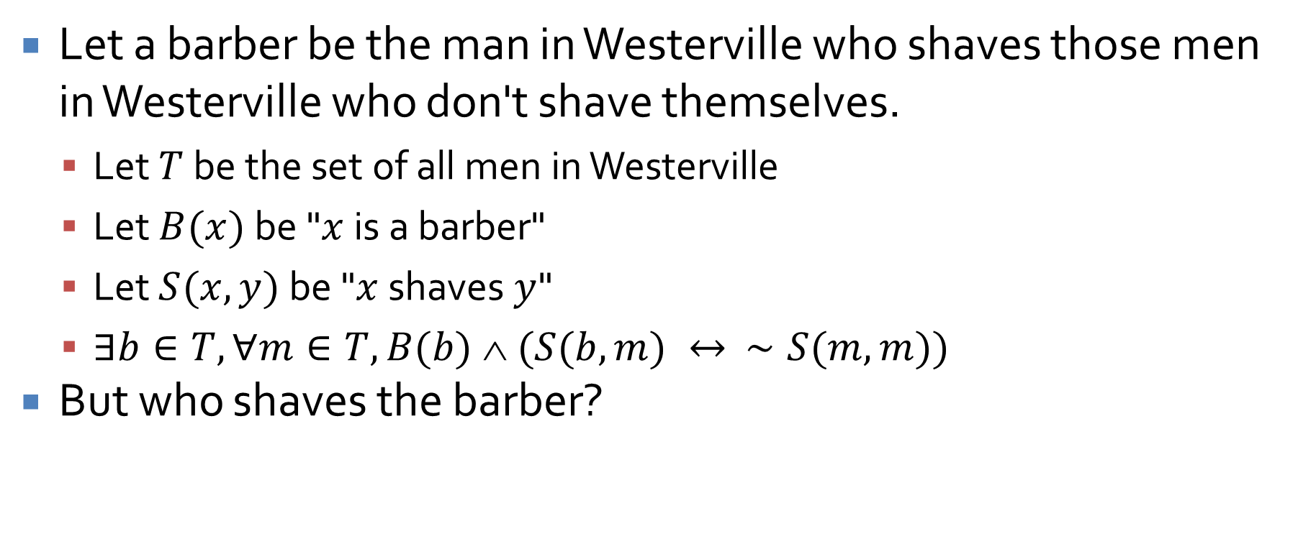
Barber Paradox
Let a barber be the man in Westerville who shaves those men in Westerville who don't shave themselves.
  Let $T$ be the set of all men in Westerville
  Let $B(x)$ be "$x$ is a barber"
  Let $S(x,y)$ be "$x$ shaves $y$"
  $∃b∈T, ∀m∈T, B(b)  (S(b,m) ↔ ∼S(m,m))$
But who shaves the barber?

Slide 33
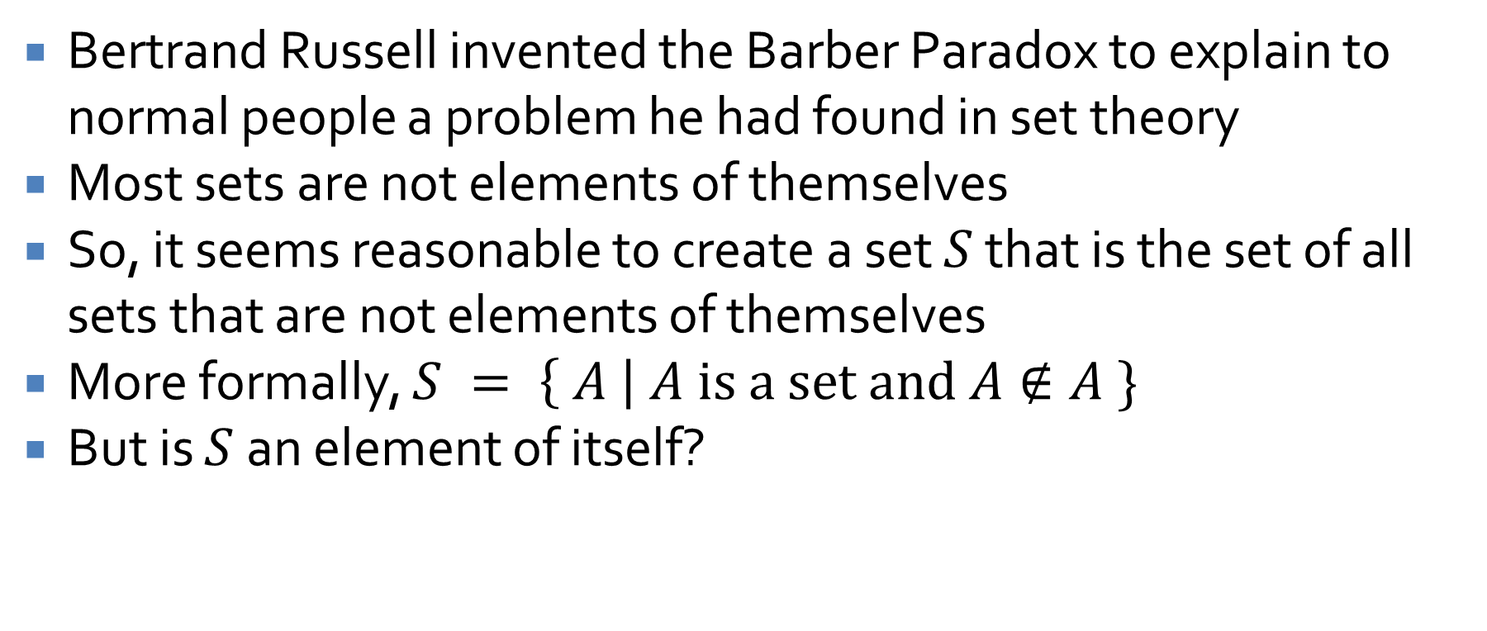
Russell's Paradox
Bertrand Russell invented the Barber Paradox to explain to normal people a problem he had found in set theory
Most sets are not elements of themselves
So, it seems reasonable to create a set $S$ that is the set of all sets that are not elements of themselves
More formally, $S = \left\{ A \right| A is a set and A∉A \}$
But is $S$ an element of itself?

Slide 34
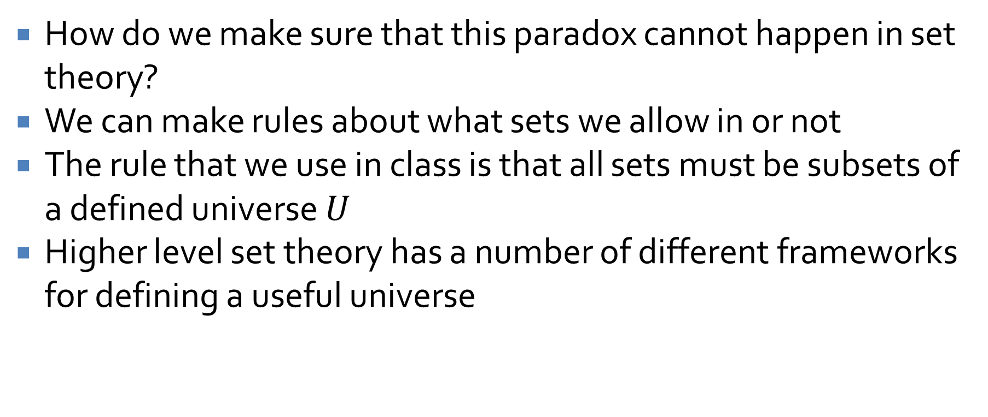
Escaping the paradox
How do we make sure that this paradox cannot happen in set theory?
We can make rules about what sets we allow in or not
The rule that we use in class is that all sets must be subsets of a defined universe $U$
Higher level set theory has a number of different frameworks for defining a useful universe

Slide 35
Upcoming

Slide 36
Next time…
Halting Problem
Cardinality
Relations

Slide 37
Reminders
Start Assignment 3
  Due next Friday
Read 7.4 and 8.1

